Slide 1
Mass Uprising of 1969
The 1969 uprising in East Pakistan was a democratic political movement in East Pakistan (now Bangladesh). The mass uprising in 1969 is that the entire people of East Pakistan staged against the dictator Ayub Khan on the basis of six points and 11 points in 1969 with the aim of implementing democracy and establishing autonomy and ending all anti-people forces and military rule is known as the 1969 uprising.
The mass uprising of 1969 brought down the oppressive and
dictatorial ruler Ayub Khan.
Background of the Mass Uprising in 1969 :
Reluctance to grant autonomy to East Pakistan.
An unreasonable decision to make Urdu the state language.
The election of 1954.
Military rule which was imposed in 1958.
Boundless inequality between East and West Pakistan.
Students movement of 1962 and 1964
Six point movement and reluctance to grant autonomy.
Agartala conspiracy case of 1968.

Slide 2
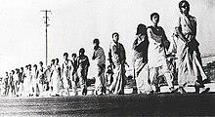
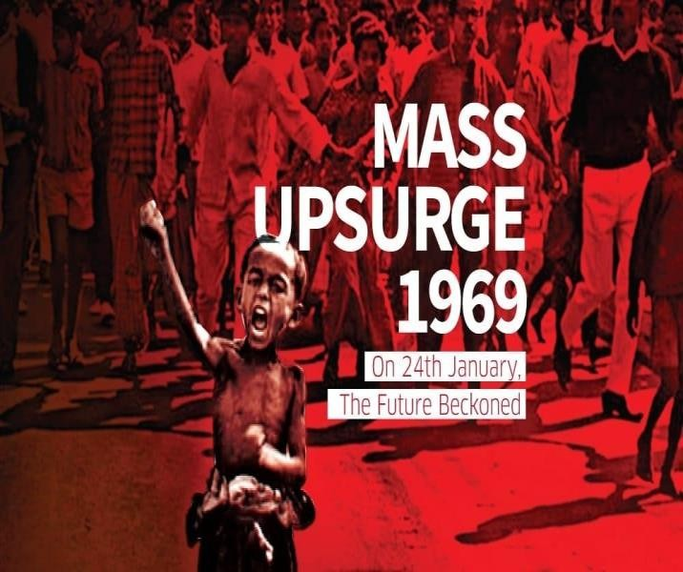
Events of Mass Uprising :
The mass uprising of 1969 was divided into several stages.
From 6th December to 29th December, 1968
From 4th January to 19th January 1969.
January 20, 1969 to February 22.
From February 23 to March 25, 1969.

Slide 3
The student agitation turned into a vigorous mass movement under the leadership of Maulana Bhashani.
December 6, 1968:
The National Awami
Party, East Pakistan Workers' Federation and
East Pakistan Peasants' Association arranged a public meeting at Paltan Maidan to observe the Repression Resistance Day on 6 December 1968.
Maulana Bhashani declared a hartal the next day, following the violent clash between the police and the demonstrators.
December 10, 1968: Awami League observed December.
Repression Resistance Day on 10
December 29, 1968:
A 'gherao' program was staged on 29 December.
January 4, 1969
The leaders of Chhatra League, Chhatra Union (Matia and Menon group) and Dhaka University Central Students Union (DUCSU) sat together on 4 January 1969 and formed a united front known as Sarbadaliya Chhatra Sangram Parishad (All Parties Student Resistance Council).
Chhatra Sangram Parishad presented 11 points program, a combination of the six points of Bangabandhu and few other demands.11 points got support of the Bangalees from all strata of life very soon.

Slide 4
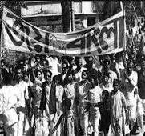
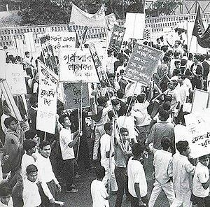
January 8, 1969:
Eight parties formed an alliance known as
Committee/DAC) and placed forward 8 points demand.
(Democratic
Action
January 20, 1969:
Students observed hartal in East Pakistan to protest that brutality. During hartal police fired open in front of Dhaka Medical College and a student leader Asaduzzaman was killed.
February 15 & 16:
Sergeant Zahurul Haque, an under-trial prisoner in the Agartala Conspiracy Case, was killed brutally by gun shot in Dhaka Cantonment on 15 February. The movement triggered off in protest of the killing of Zahurul Haque on 16 February.
February 18, 1969:
On 18 February the army bayoneted Dr. Mohammad Shamsuzzoha, the then Proctor of Rajshahi University and killed him.
Ayub Khan could realize that the situation would go beyond control unless the Agartala Case was withdrawn and the accused people were released. All the accused including Sheikh Mujibur Rahman were released on 22 February 1969 and Agartala case was withdrawn. Then Ayub Khan declared that he would not contest in the next presidential election and in 25th March he gave the power to Yahya Khan.

Slide 5
Importance/Significance of the Mass Uprising :
On March 25, 1969, Ayub Khan was forced to resign.
The Agartala conspiracy case was withdrawn on 22 February.
Sheikh Mujibur Rahman was conferred the title of Bangabandhu.
Awareness of rights of Bengalis increased.
Democratic aspirations are awakened.
Inequality between East and West Pakistan came to an end.
The political prisoners were released from prison.
Bengali nationalism was created.
The mass uprising of 1969 played a vital role in 1970 elections.
The mass uprising of 1969 inspired the war of independence

